Slide 1
MANAGING STRESS
AS
A
STUDENT

Slide 2

students

Slide 3

Introduce Stress and its effects
Identify common stressors and interventions
Demonstrate a stress relieving activity

Slide 4


Notes:
Ask class their definition of stress

Slide 5

Stress is the combination of a stressor and reactivity to that stressor
  Stress = Pressure – Adaptability
  *People can learn to control their stress

Slide 6

A stressor is known as anything that has the potential to cause a stress reaction.
Notes:
Ask class what type of stressors they experience

Slide 7

A reactivity, also known as fight-or-flight,
  increases the heart rate
  Increases respiration
  Increases blood pressure
  muscle tension or “bracing”
  perspiration

Slide 8

Alarm Reaction: body shows changes to the first exposure to stress
Resistance: stress products build up, but the body’s physiology adapts by resisting the effects of stress products.
Exhaustion: after long-term exposure to stressors, the resistance energy is used up.

Slide 9

Eustress =
stress that results in positive consequences
Examples:
  Marriage
  Graduation
  Having a baby
  Spring break
Distress = stress that results in negative consequences
Examples:
  Financial loss
  Projects
  Illness
  Getting fire

Slide 10


Slide 11

Three Areas:
Physical
Emotional
Cognitive
Notes:
The body does not distinguish between negative and positive stress. This means that the same physiological responses can take place whether you are happy or sad about a given situation

Slide 12

Response by the Heart, Lungs, and Circulation
The Immune System's Response
Notes:
Response by the Heart, Lungs, and Circulation to Acute Stress
Breathing becomes rapid and the lungs take in more oxygen.
Blood flow may actually increase 300% to 400%, priming the muscles, lungs, and brain for added demands.
The spleen discharges red and white blood cells, allowing the blood to transport more oxygen.
The Immune System's Response to Acute Stress
The steroid hormones dampen parts of the immune system, so that infection fighters (including important white blood cells) or other immune molecules can be redistributed.
These immune-boosting troops are sent to the body's front lines where injury or infection is most likely, such as the skin, the bone marrow, and the lymph nodes.

Slide 13
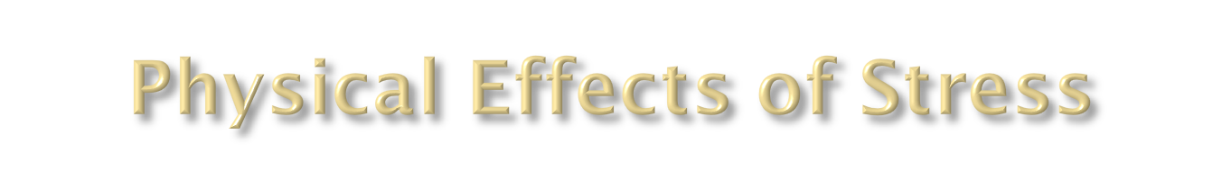
The Response in the Mouth and Throat
The Skin's Response
Metabolic Response
Notes:
The Acute Response in the Mouth and Throat
Fluids are diverted from nonessential locations, including the mouth. This causes dryness and difficulty in talking. In addition, stress can cause spasms of the throat muscles, making it difficult to swallow.
The Skin's Response to Acute Stress
The stress effect diverts blood flow away from the skin to support the heart and muscle tissues. The physical effect is a cool, clammy, sweaty skin. The scalp also tightens so that the hair seems to stand up.
Metabolic Response to Acute Stress
Stress shuts down digestive activity, a nonessential body function during short-term periods of physical exertion or crisis.

Slide 14
Examples include…
muscular tension
colds or other illnesses
high blood pressure
indigestion
ulcers
difficulty sleeping
fatigue
headaches
backaches

Slide 15
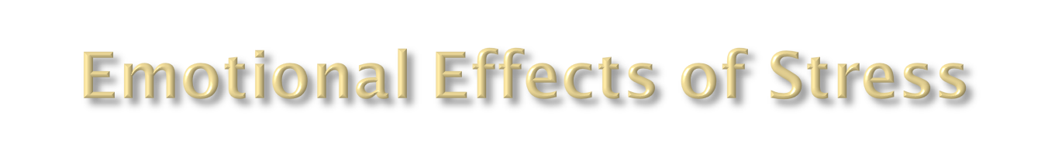
Anger
Minor Problems
Family, Friends and Loved Ones
Notes:
Anger is one such problem especially, if the individual feels frustrated or isolated by a stressful situation.
Minor problems such as unhappiness and impatience for things to get back to normal can quickly grow into more serious problems, such as clinical depression and anxiety disorders.
Loved ones can get pushed away, and the stressed individual may withdraw from society and their life in general.
Eventually friendships break down, and the individual becomes more stressed and withdrawn because of their lack of social interaction; it’s a never-ending cycle.

Slide 16
Hostility
Irritability
Anxiety
Sadness
Depression
Powerlessness
Total overwhelm
Examples include…

Slide 17
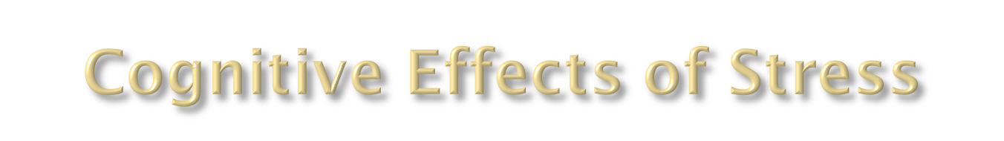
Memory, Concentration, and Learning
Brain
Effect of Acute Stress on Memory
Effect of Chronic Stress on Memory
Notes:
Brain
Stress has significant effects on the brain, particularly on memory. The typical victim of severe stress suffers loss of concentration at work and at home and may become inefficient and accident-prone. In children, the physiologic responses to stress can clearly inhibit learning. Although some memory loss occurs with age, stress may play an even more important role than simple aging in this process. In one study older people with low stress hormone levels tested as well as younger people in cognitive tests: those with higher stress levels tested between 20% and 50% lower.
Effect of Acute Stress on Memory.
Studies indicate that the immediate effect of acute stress impairs short-term memory, particularly verbal memory. In one interesting 2000 study, subjects took pills containing either cortisone (a stress hormone) or a placebo (a dummy pill). Those taking the cortisone performed significantly worse on memorization tests than those taking the placebo pill did. In an earlier study, when individuals were subjected to four days of stress, verbal memory was also impaired. Fortunately, in such cases, memory is restored after a period of relaxation.
Effect of Chronic Stress on Memory.
Studies have strongly associated prolonged exposure to cortisol (the major stress hormone) to shrinkage in the hippocampus, the center of memory. For example, two studies reported that groups who suffered from post-traumatic stress disorder (Vietnam veterans and women who suffered from sexual abuse) displayed up to 8% shrinkage in the hippocampus. It is not yet known if this shrinkage is reversible.

Slide 18
Examples include…
forgetfulness
unwanted or repetitive thoughts
difficulty concentrating

Slide 19


Slide 20
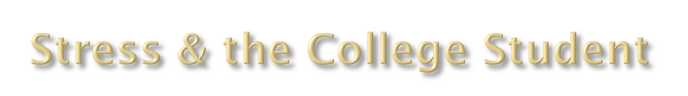

Lifestyle Changes
Classes and Grades
Finances
Friendship
Relationships
Career Choices

Slide 21

Definition:
“activities to prevent a stressor from resulting in negative consequences”
Examples:
Exercise Time Management
Proper Nutrition Social Support

Slide 22


Slide 23

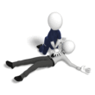

Slide 24
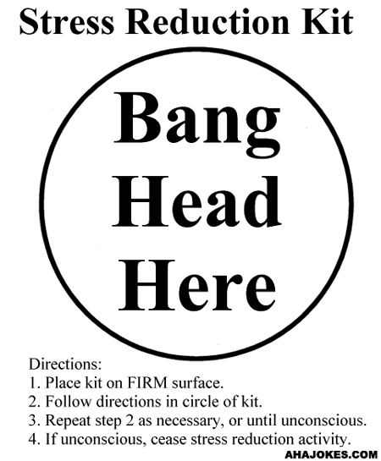
Notes:
I thought this would be funny to end with or start with while we are waiting….just a thought!--EJ

Slide 25

Meditation is designed to gain control over your attention so you can choose what to focus on.
Involves focusing upon either something repetitive or something unchanging.

Slide 26

Meditation is used as a treatment for the following:
Muscle Tension
Anxiety
Drug Abuse
Hypertension
It lowers blood pressure, heart & respiratory rates and increases blood flow in the arms & legs.

Slide 27

Multiple exercises designed to bring body warmth and heaviness in the limbs and torso.
Autogenic means “self-generating” and refers to the fact that the response is self-induced.

Slide 28
Autogenics is used as a treatment for the
following:
1. Raynaud’s Disease 6. Constipation
2. Migraine Headache 7. Writer’s Block
3. Insomnia 8. Indigestion
4. Hypertension 9. Ulcers
5. Bronchial Asthma 10. Lower Back Pain

Slide 29

Progressive relaxation is a technique used to induce nerve-muscle relaxation.
It involves contraction of a muscle group and then relaxation of it, progressing from one muscle group to another throughout the body.

Slide 30

Progressive Relaxation is used to treat the
following:
Tension Headaches
Migraine Headaches
Backaches
Depression
Anxiety
Insomnia

Slide 31



Slide 32

Please quickly split into 5 discussion groups throughout the room

Slide 33

Chevins, C. (2001). Stress. Retrieved on September 2006 from, http://www.reutershealth.com/wellconnected.doc31.html
Constandse, R. (2004-2006). Symptoms of Stress. Retrieved on September 2006 from,http://www.timethoughts.com/stress/symptoms-of-stress.htm
National Mental Health Association. Retrieved September 2006 from http://www.nmha.org/camh/college/fact_sheets.cfm
Siemion, G. Top 10 Stress Busters. Retrieved on September 2006 from,http://honolulu.hawaii.edu/intranet/commitees/FacDevCom/guidebk/techtip/top10stress.htm
University of Ottawa. (2006). Health Information. Retrieved on September 2006 from, http://www.uottawa.ca/health/information/stress-effects.html, revised on March 2006

